Slide 1



BROOKLINE ROTARY CLUB
Club Assembly Meeting
November 20, 2014

Slide 2

Welcome, Guests!

Slide 3
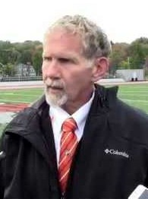
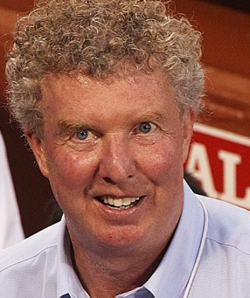
30th Annual Thanksgiving Gridiron Luncheon
Held jointly with the Newton Rotary club
Tuesday, November 25
(This is instead of our
regular meetings)
Brae Burn Country Club
Dan Shaughnessy will speak

Slide 4
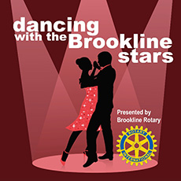

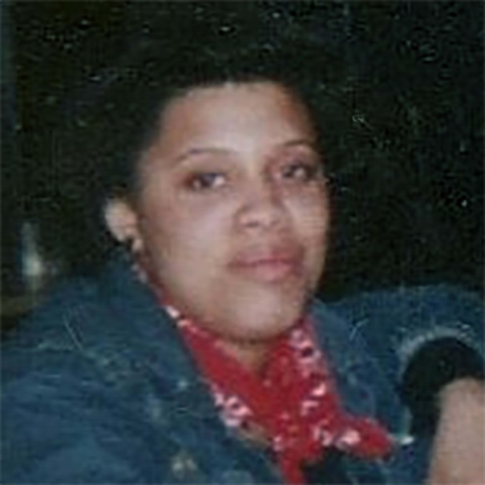
DTWBS / Kwansa
December 11
Checks will be distributed to our dancers
Joanne Silva-Njuko will tell us about Kwansa

Slide 5

Yankee Swap
December 18
Bring a gift of about $20
Suitable for a
man or woman

Slide 6
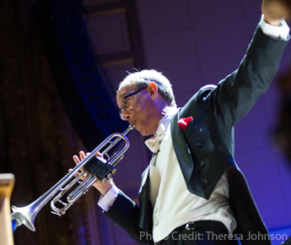
New Year’s Eve
Boston Pops Swing Orchestra
$150/seat
Rotary group
Buffet
before in Brookline
Reserve by
December 1

Slide 7
Breakfast Club Report
8 people this morning
Presentation by Eugene of the EXcel program

Slide 8

Visioning and Brainstorming for Next Year’s Grant Projects
Clarity
Continuing
Consistency
Revisit the plan
every three years

Slide 9
Evaluation and Visioning
“Evaluation is not easy nor free from conflict, but it helps create a lens for considering change for the good.”
– Winston Churchill

Slide 10

Why Is a Plan Needed?
Tradition of annual cycles has not been effective
Establishes a multi-year coordinated plan
Need for greater continuity, consistency, and consensus
Notes:
STEVE:
Why is a Plan Needed? Annual Cycles, Multi-Year Coordinated Plan resulting in Continuity, Consistency and Consensus. Efficiency is also a critical outcome of the planning process…the concept that having a plan (and statement of purpose) allows the opportunity for all club members to say who the club is and what they stand for in their community. When this is relevant to the community and communicated (both inside the club and outside-public image), retention and recruiting will become easier.

Slide 11
Why Do We Need a Strategic Plan?
Continuity
Consistency
Consensus
The Leadership Team changes each year, but the goals and objectives of the club carry forward.
Vice President
President-elect
President
Immediate Past-Pres.
2013
2014
2015
Candidate
resigned
Joyce Graff
Phil Sandler
Justin Berke
You?
Joyce Graff
Phil Sandler
You?
Joyce Graff

Slide 12
Why a Strategic Plan?
Members of clubs with a strategic plan:
  Are more satisfied
  Have a more positive view of their club
  Have a more positive view of Rotary as a whole
March 2014 survey of clubs:
  45% of clubs worldwide do have a plan
  Clubs with plans had 16% higher satisfaction rating

Slide 13
Top Strategic Issues
The Top Three Strategic Issues | Today | In Ten Years
Membership recruitment and retention | 68% | 68%
Membership diversity (age, gender, etc.) | 32% | 29%
Innovation, modernization, flexibility and/or simplification of processes and rules | 29% | 32%
Public awareness of Rotary | 27% | 21%
Maintaining and promoting core values | 21% | 27%
Developing leaders | 21% | 21%
Polio eradication | 21% | 6%
Programs for youth and young leaders | 17% | 21%
Collaborating and connecting within Rotary | 11% | 8%
Rotary's public relations activities | 10% | 8%
Collaborating and connecting with other organizations | 8% | 11%
Fundraising | 8% | 8%
Financial sustainability | 8% | 17%
Areas of focus | 6% | 10%
Strategic planning | 6% | 6%
Club public relations activities | 5% | 5%
Other | 3% | 3%
Top Three Strategic Issues | Today | In Ten Years
Membership recruitment and retention | 68% | 68%
Membership diversity (age, gender, etc.) | 32% | 29%
Innovation, modernization, flexibility and/or simplification of processes and rules | 29% | 32%
Notes:
JOE:
In the March 2014 survey about the future of Rotary, a representative sample of Rotarians told us that membership recruitment, retention, and diversity are all top strategic issues for their clubs today and in ten years.
In addition, a fairly significant group of respondents felt that innovation, modernization, flexibility and simplification of rules and processes in Rotary and our clubs are major obstacles in furthering the Rotary cause.
One might conclude we have a product issue. Is our product—the Rotary club experience—meeting the needs of our members, prospective members, and our surrounding communities?
What we want to offer today are ways to explore what is working or not working in your clubs, and how best to adjust your activities and approaches in delivering the Rotary experience.

Slide 14
Strengthening Clubs
Question | Strongly Agree | Agree | Somewhat Agree | Somewhat Disagree | Disagree | Strongly Disagree | Don't Know / Undecided
I have the opportunities I want to connect and collaborate with other Rotarians -- across clubs and districts | 16% | 43% | 26% | 8% | 4% | 1% | 1%
My club does a great job involving new members in our club's activities, projects, and programs | 15% | 34% | 30% | 13% | 6% | 2% | 0%
Rotary provides members sufficient opportunities for professional networking | 12% | 37% | 30% | 12% | 6% | 2% | 2%
My club involves each member in activities according to the member's interests, skills, and availability | 13% | 33% | 30% | 14% | 6% | 2% | 1%
Notes:
JOE:
The March 2014 survey further explored feedback from club members around involvement, networking, and matching of skills.
Any trend of 20% or greater in the negative needs some attention.
We realize that membership retention is our greatest challenge—we lose roughly 100,000 members per year.
And, getting members engaged early and often around what matches their skillsets or interests is the key to retaining members.
The data shows that roughly 20% of our members are not involved or engaged to the level that meets their needs.

Slide 15
Time for Transitional Change?
Transforming our product
Relevant to today’s market and societal needs
Questioning the status quo
Identifying new growth opportunities for Rotary’s future
How can we prosper over the next 100 years?
Re-emergence
Success Plateau
Wake Up Calls
Chaos
Growth
The End?
Birth
Notes:
JOE:
We all recognized that any business or organization has a lifecycle.
Those who grow from their origination at some point in time are likely to hit a plateau of growth or success.
The strong organizations proactively anticipate those plateaus and reinvent their products and services before they begin to flatten.
Some don’t and have to react to chaos or wake-up calls before the re-emerge.
While others don’t do anything and meet their ultimate demise.
Rotary has grown significantly in the last 50 years—in expansion, members, donations, service efforts, and recognition.
We continue today to provide value to our members—but has the time come to transform our product because we’ve hit a bit of a plateau in our ability to demonstrate value to those who want it the most—the soon to be or recently retired and the next generations.
The competitive landscape in the volunteer, civic service arena is overloaded with supply. It’s not the same as it was 20 or 50 years ago.
What is the best way for you to understand your club’s future? Transform your product, if need be? Stay relevant to today’s market and societal needs? Question the status quo? Or identify ways to continue to grow Rotary and help it prosper another 100 years?
It’s important to reflect on what is working and what is not. Evaluate your club’s performance.
I know my club is going through these same challenges. We’ve looked in the mirror and said we need to change.
We are making progress, but it is not easy.

Slide 16

Club Assessment Tools
Evaluate your club’s
strengths
Identify weakness
Obtain feedback from
club members and
community
Discuss strategies to address weaknesses and opportunities
Implement new strategies and tactics
Monitor progress
Available on rotary.org and shop.rotary.org
Notes:
The Club Assessment Tool is getting a new look and a new name in Spring 2015.
Be on the lookout for it.
But, the same concepts are included;
• Evaluate your club
• Identify your weaknesses and opportunities for improvement
• Get feedback—from members and community
• Discuss how to correct the weaknesses and take advantage of the opportunities
• Implement a few key initiatives to address what you can change
• And monitor how it is going…check in regularly.

Slide 17


What Is a Club Vision?
It is a living management tool that:
Defines a shared commitment
Provides long-term direction
Creates a framework to establish goals and objectives
Optimizes use of resources
Notes:
STEVE:
Club vision is a living management tool, it defines a shared commitment among those present.
Simply stated, as club and district leaders, our organization will benefit when clubs “see themselves not as they are but as they can become.”
Your resources are your people and your people need to be pulling in the same direction….

Slide 18






Continuity and Consistency
VISION
Success
2016
2015
2014
Consensus
Annual plans, projects, programs
Notes:
STEVE:
Continuity from year to year in our programs and services is what makes our organization strong. This stair step of leadership represents more than just “your” year it represents all that came before you and the legacy that follows. This is about YOUR leadership toward Club Planning.
You want clubs to capitalize on their unique history, to develop during this year, and to anticipate the future.
When clubs internalize this “staircase,” club presidents realize they don’t have to “do it all in their year.” The implementation of specific visions will often exceed the 12 months they are in office. They can be comfortable in knowing they have ascended another step on the staircase that built on the past, emphasized the present, and was a precursor of the future.

Slide 19
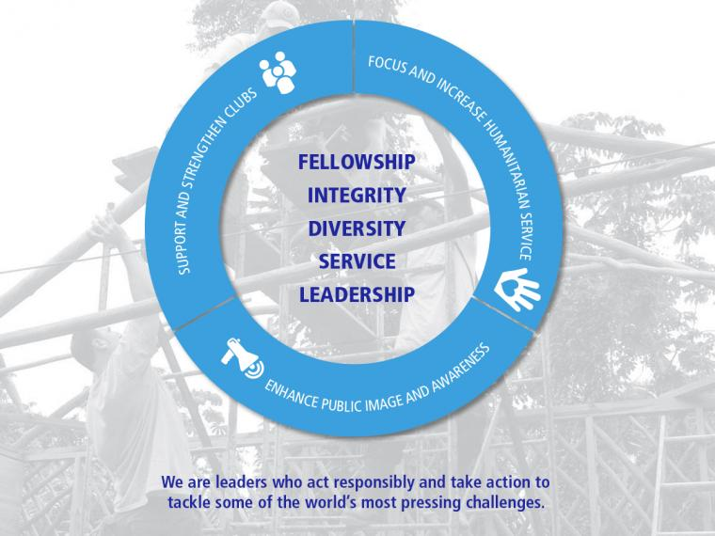
Strategic Thinking
Notes:
STEVE:
An element of Strategic focus and thinking related to the Strategic Plan… a reference of tie back to the RI Strategic Plan.
The Board has agreed to simplify the strategies into three specific priorities effective 1 July 2010. The Board reaffirmed these priorities in June 2013:
Focus RI’s activities on supporting, strengthening, and developing clubs to fulfill Rotary’s mission. Clearly, membership grows from strong and viable clubs, and the appeal of Rotary continues to lie in Rotary service and networking initiated through our clubs. Rotary has to promote the benefits of the “NETWORK”
Align RI and TRF’s program focus with the most popular humanitarian service interests of Rotarians. Polio eradication remains the clear humanitarian priority. It was evident from the surveys and research that Rotarians demanded focus from RI to support clubs’ service efforts in other key humanitarian projects. The RI Strategic Planning Committee and Board agreed that focus on the Rotary Foundation’s six areas of focus and youth and young adults should yield significant outcomes with focused approaches. In addition, it aligns with what Rotarians already identify as their primary humanitarian service interests.
Portray a clear message to the world about Rotary’s actions and successes both locally and internationally. Unifying our brand image is a big challenge globally.
<TRF’s six areas of focus are: peace and conflict prevention/resolution, disease prevention and treatment, water and sanitation, maternal and child health, basic education and literacy, and economic and community devel.

Slide 20
Vision to Plan
Actions and Programs
Vision
Long-Range Plan
Notes:
STEVE:
Successful organizations employ these steps to a solid action plan… The Vision To Plan Process starts out the cycle with solidifying a Club’s Vision and builds toward a long range plan that your club can put into Actions and Programs for a number of years. The clarity that will come from this process will provide the alignment within your club of activities and direction promoting membership strength in retention and growth.

Slide 21

The Basic Planning Questions
Who are you?
Where are you?
Where do you want to be?
How will you get there?
How will you know when you have arrived?
Notes:
STEVE:
In the Planning Process these are the questions you will want to consider as you work with club planning. To celebrate the individual culture of your club often a mission/passion/vision statement is produced like…Enhancing Opportunities For Youth, Creating a Better Community For All

Slide 22
Evaluate and Plan
Identify
  Strengths,
  Weaknesses
  Opportunities for improvement
Don’t bite off too much
Be a vibrant club

Slide 23
FUN
Being a Rotarian should be FUN
It’s the fun and the caring relationships that bring people back each week
We start on time
We end on time
We have a good time

Slide 24

What Does our Club “Stand For” in Our Community?
Community service focus
Entrepreneurial style fundraising
Fun, inclusive, open
It’s 2017

Slide 25
2017: What Is the Size of the Club?
75 members
60 members
70 members
It’s 2017

Slide 26
What Are the Club Characteristics, Features, Demographics?
Business people
Team members
Younger working professionals
Community activists
Retirees and newly retired
It’s 2017

Slide 27
About Our Club Administration
Adaptable for membership and service
Communicate using today’s technology (wechat, texting, instant messaging, etc.)
Active system for membership
Business skill development at meetings
It’s 2017

Slide 28
About Vocational Service
Apply the 4-way test to all decisions
Mentoring program for Rotaract grads (with a focus)
High school mentoring program
Education on financial aid
Social studies unit on
peace for middle school
and high school
It’s 2017

Slide 29
Community Service Projects
Sponsor a community needs assessment, or build upon the efforts of other groups
Plan, finance, and support programs for underserved populations
Partner and leverage the efforts of community non-profits
Support community
activities with good
purpose
It’s 2017

Slide 30
Youth Service
Provide ways for 20-30 year olds to engage in Rotary projects
Rotaract Club includes young professionals
We are the go-to club for help with student projects
It’s 2017

Slide 31
International Service
Sponsor a Peace Scholar
Partner with international Rotarians on projects
Provide a dental clinic in Honduras
Educate all members in Rotary International programs
Recruit local youth
for international
projects
It’s 2017

Slide 32
Fundraising
Dancing with the Brookline Stars raised $300K
Pancake Breakfast raised $14K and recruited 10 new members
Taste of Brookline raised $30K
It’s 2017

Slide 33
What Actions Do We Need to Take to Achieve This Vision of Our Future?
Grow membership
Recruit the people with the talents to make this happen
Public image: communicate who we are, what we do, over the right channels to reach the people we need
Train new members as future leaders

Slide 34
We Need YOU to Build the Plan
President’s Development Team
Judy Moses, Vision Champion
Working group to create the plan

Slide 35

Happy Dollars

Slide 36

Let’s Light Up Rotary

